Slide 1

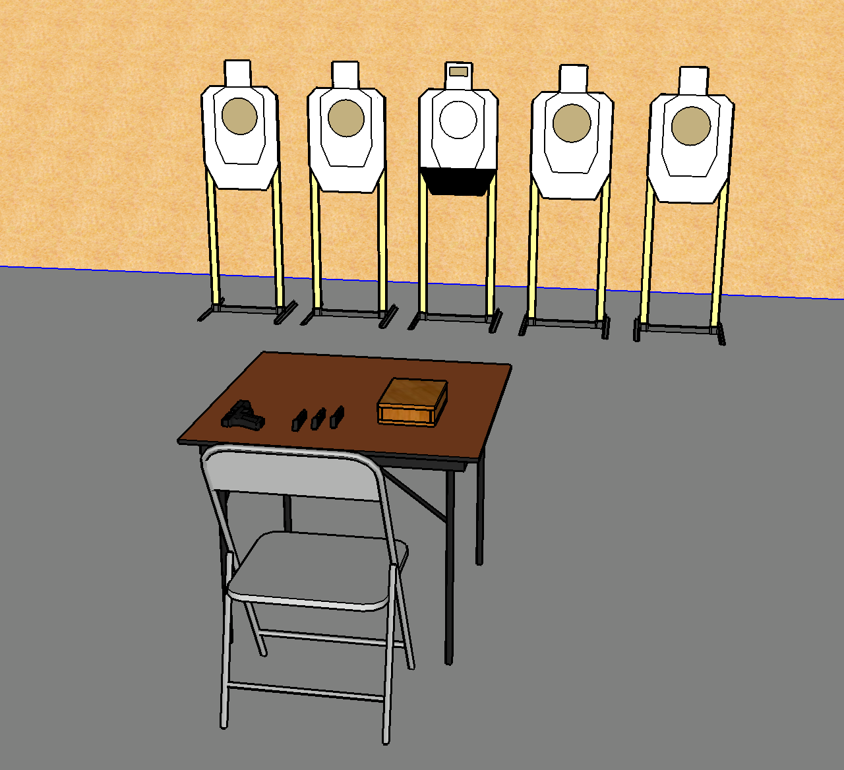
 | Interlake Sporting Association SUR, A Stage: Eyes Are The Window To The Precious Course Designer: Brian Chinn & Marcel Englmaier
START POSITION: Sitting in chair, unloaded firearm on table pointed downrange. All Loading devices downloaded to 5 and on table.
STAGE PROCEDURE: At the start signal, engage all targets with 2 shots each while seated. |  | STRINGS: 1 SCORING: Comstock SCORED HITS: 2 ROUND COUNT: 10 TARGETS: 4 paper, 1 precious START-STOP: Audible - Last shot Muzzle Safe Points: 180 degree rule

